Slide 1
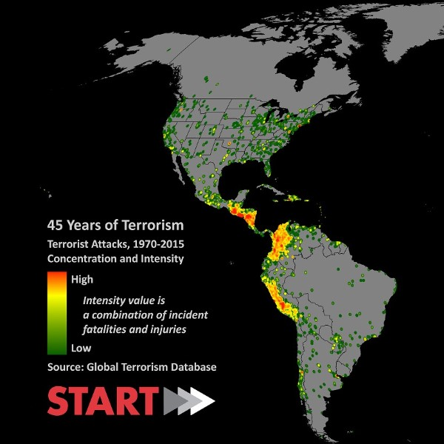
Global Terrorism Database
Mentored by:
Meenakshi Jha Jatinder Bedi
Ankita Epari
Kallu Chandrakanth Reddy
Uppu Pavan
GROUP 9 :

Slide 2
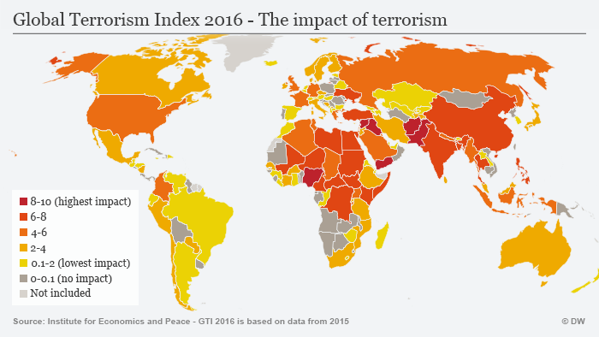
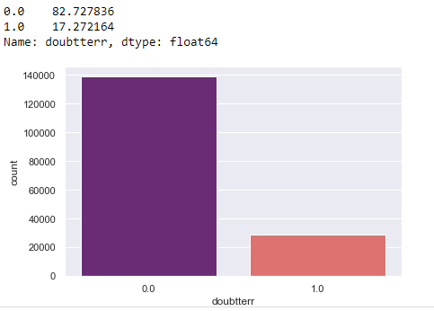
Introduction to the Data ,Problem statement
Dataset:The Global Terrorism Database (GTD) is a database of incidents of attacks from 1970 onwards. As of July 2017, the list extended through 2016, with an incomplete data of 1993 due to issues with that year.
Domain : Crime
Objective: This research is conducted in order to determine if an event in the Global terrorism Database can be classified as exclusively terrorist as per the global norms or other forms of crime.
Target/Dependent Variable:’Doubterr’-Doubt terrorism proper(0: Activity is confirmed terrorist,1:Activity comes under other forms of crime)
Shape: The Global Terrorism database has 181691 rows and 135 Columns.
Techniques: Supervised Learning Classification, Unsupervised Learning.
Background & need for study
Scope & Objectives
Project justification
Academic value
Social value
Complexity involved

Slide 3

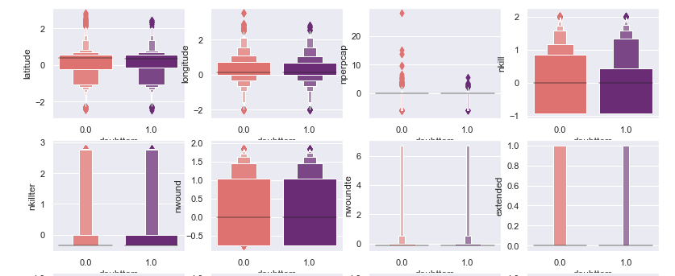
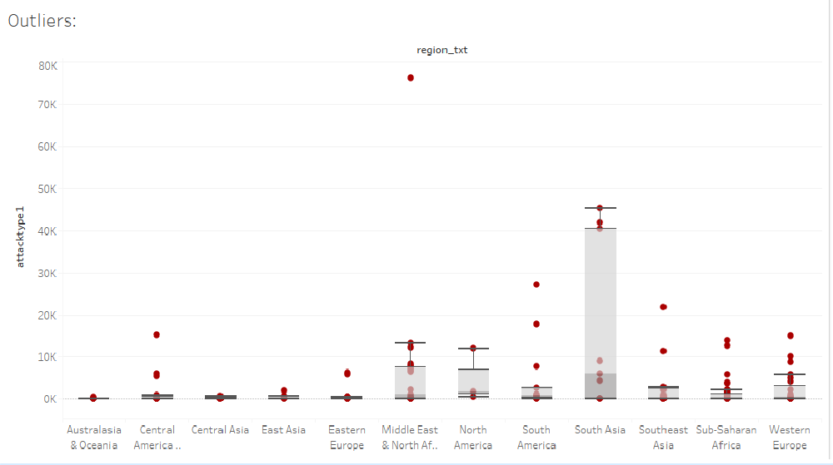
Data Dictionary and Data Cleaning
Data Dictionary : Variables: >100 variables on location, tactics, perpetrators, targets, and outcomes
1.Geography: Worldwide 2. Unit of Analysis: Attacks 3.Source: START(National Consortium , U.S)
Variable Categorisation :58 Object Columns or Categorical columns,55 float columns and 22 integer columns.
Missing/Null values in the data and their treatment
Presence of Outliers in the Data
latitude, longitude, number of perpetrators captured, number of kills, number of people/terrorists wounded has outliers, we must be accepting the outlier's as they are the important events that recorded extreme values in deaths and the number of wounded individuals.

Slide 4
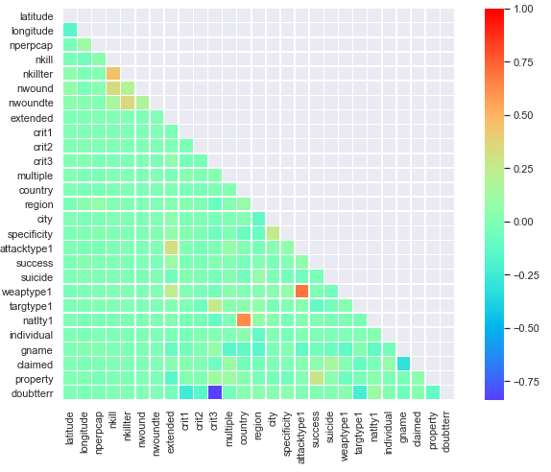
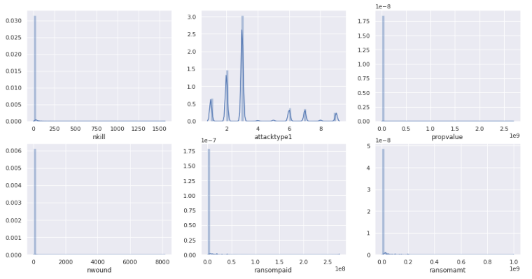
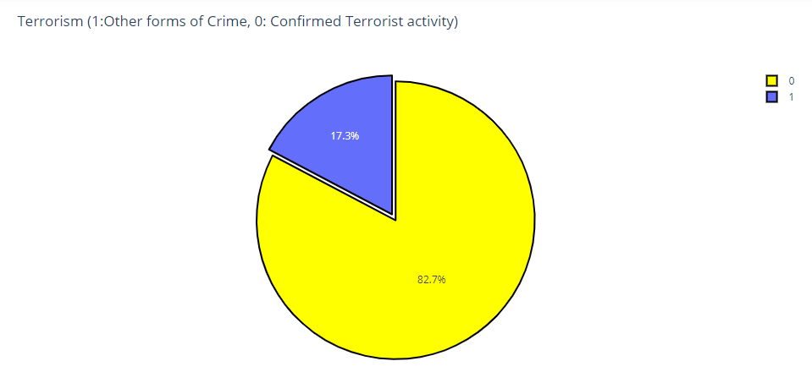
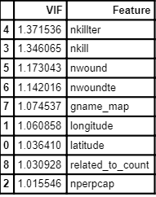
Exploratory Data Analysis
Interactive Dashboards
Multicollinearity : high correlations among predictor variables was barely found in the global terrorism database dataset.
Distribution : Most Data was positively skewed or Right skewed.
Class Imbalance:Here the majority class is (‘0’): Exclusively terrorist activity and the minority class is the (‘1’): Doubtful activities.

Slide 5
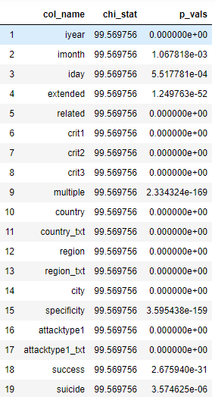
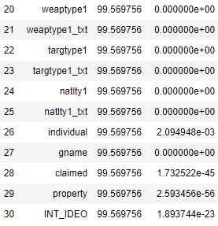
Statistical analysis Categorical
Statistical significance:
We have performed the following tests on our data:
Categorical Columns:
for categorical columns with target variable, chi-square test of independence has been used.
Ho: The null hypothesis for this test is that there is no significant relationship between doubtterr and other categorical variables.
H1: The alternative hypothesis is that there is a significant relationship between doubtterr and other categorical variables.
The pvalues of all the categorical variables are subsequently lower than the critical value (0.05).
The observed chi-square test statistic in our case is greater than the critical value (0.05), hence the null hypothesis can be rejected.
Hence,we conclude that all the Categorical variables are significant.
Pvalues of Chisquare test:

Slide 6
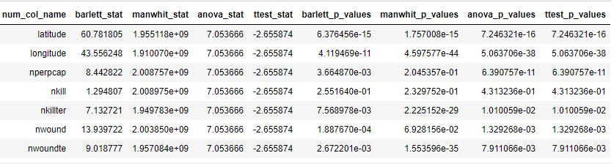
Statistical Analysis (Numerical with Target variable)
Numerical Columns:Numerical Columns: For testing the significance of numerical columns with Target variable, the following tests have been performed:
ANOVA;
Ho=µ1=µ2= µ3
H1=µ1≠µ2= µ3 or µ1=µ2≠ µ3 or µ1=µ3≠ µ2 or µ1≠µ3≠ µ2
2. Barlett test;
Ho= σ²= σ²= σ²
H1= : σ²i≠σ²j for at least one pair(i, j)
Mann-Whitney test;
Ho= the distributions of both populations are equal
H1=the distributions of both populations are unequal
Two Sample Independent T test; Ho =u₁ = u_{2 H1 =} u₁ ≠ u₂

Slide 7
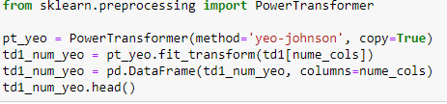
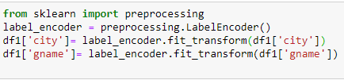
Feature Engineering
List of Techniques Used:
Feature Selection.
Transform.
Label Encoding.
Feature Selection :It is the process of selecting a subset of relevant attributes to be used in making the model in machine learning. We make the use of Statistical tests and Backward elimination in order to improve the classification performance and/or scalability of the system. Backward elimination helped us in selecting important features that we can give as an input to our model.
Transform: The data has substantially positive skewness and hence we will have to use the transformations to make it near normal. Methods used : Scaling and Yeo Jhon transformation.
Label Encoding: we will convert the categorical to numerical with label encoding. In our data we have label encoded two categorical columns: City and Group name of the terrorists.

Slide 8

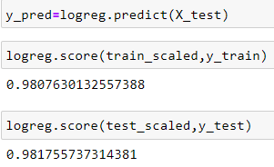
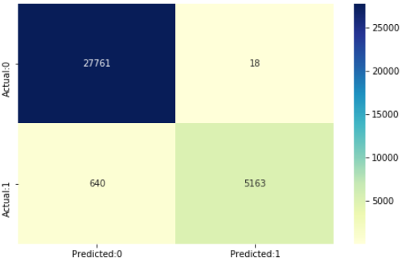
Modelling with Null Imputation
Our base model was Logistic Regression
Scores:
training score- 0.98
test score - 0.98
accuracy - 98.04%
Performance of different classification models after applying Cross Validation:
Model ACC Bias err Variance err
Logistic Regression-- 98.08 % 1.92% 0.044%
Gradient boosting-- 98.09% 1.91% 0.023%
Xgboosting -- 98.12% 1.91% 0.022%

Slide 9

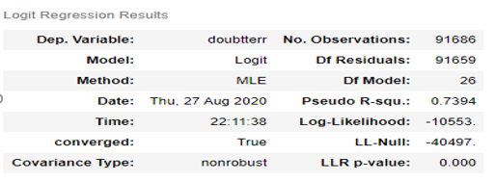
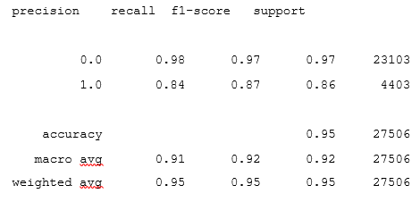
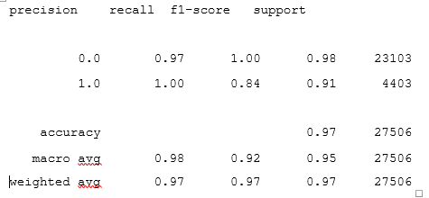
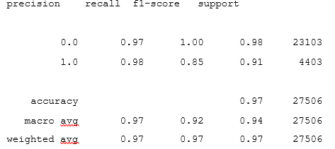
Modelling by dropping the nulls
Logit Model: Decision Tree:
Accuracy:- 95.40%
Logistic Regression: Accuracy: 95.75% Naïve Bayes:
Accuracy—95.75%

Slide 10

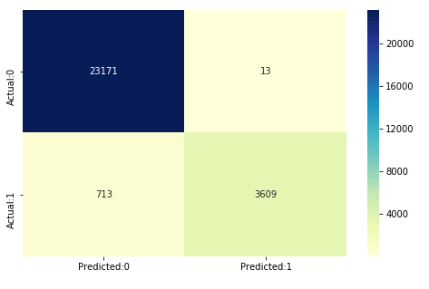
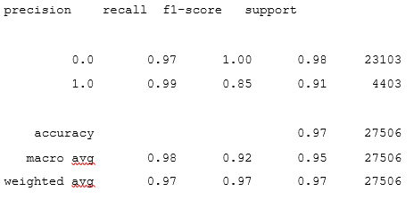
Random Forest : KNN MODEL:
Accuracy --97% Accuracy—97.06%
We have performed all these models using cross validation technique.
Null Value imputation is risky and might lead to misleading results and interpretations and hence we consider these models in our Domain that is built by dropping all the null values assuming that the values are null due to no data of that particular event.
Our final model we consider is Random forest and KNN because of their good performance.

Slide 11

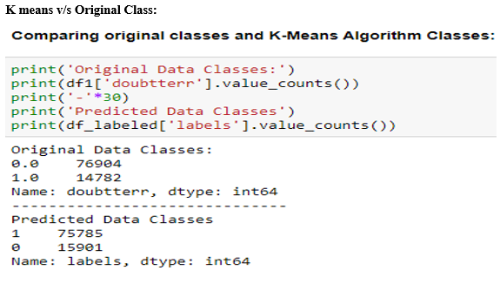
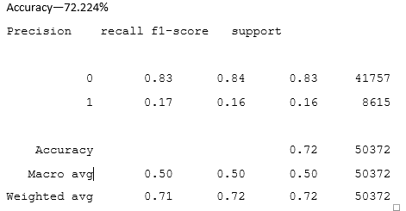
Performing Unsupervised Learning using K-means Algorithm, P.C.A, SMOTE
SMOTE:
However, in our domain we do not strive to treat the class imbalance as it is evident that the gtd will have more terrorist activities and less events of other forms of crime.
SMOTE might tamper the results by making both classes alike, which we don’t wish for in this Domain.
PCA after dropping all the null values:-
We have observed that in both the cases, with the imputation of nulls or after dropping nulls, P.C.A does not improve the scores.
From the comparison of original classes and k-means algorithm classes, it is observed that our algorithm is classifying correctly for most of the classes.

Slide 12

Recommendations
Latitude and Longitude act as important parameters to decide if an attack in a particular region can be called terrorist or not.
Once we are aware of the Latitude and longitude of the regions that have a tendency of being attacked potentially, we can take the following steps:
Government can mark that area in the public map as a Red Alert and restrict public movement in that area.
The administration can also increase surveillance in that area and have more cameras both hidden and visible so that even if the visible cameras are dismantled, the footages can still be recorded from the hidden ones, this in turn will leads to an arrest of the suspicious individuals.
More security troops should be sent in that area in undercover form.
More hospitals and healthcare should be made available to individual’s in that area so that even if there is an attack despite the aforementioned steps, the risk of death can be reduced by proactive medical treatment and support.
Number of perpetrators captured is another parameter of great significance as shown by the model. Reason being, if the perpetrator is captured, it can be known clearly about the motive of attack and whether or not it meets the three criterions to call them terrorist. If it is terrorist, then the intelligence bureau can launch further investigations to find out what groups or countries are responsible for this.
Direct economic advantage or the Risk Mitigation done by the model: Property damage is another significant feature identified by our model . This implies that the latitude and longitude where there are frequent property damages and the areas in the vicinity of it can be annually insured by the government for the property damage to minimize, monitor, and control the probability or impact of unfortunate events or to maximize the realization of opportunities.

Slide 13

Thankyou

